Slide 1
Cross selling recommendation
Team member's details:
Jingxi Liao, liaojingxi@gmail.com, Canada, University of Glasgow, Data Analytics

Slide 2
Introduction
Problem description:
How to increase cross selling of Banking Products -- XYZ credit union in Latin America is performing very well in selling the Banking products (eg: Credit card, deposit account, retirement account, safe deposit box etc) but their existing customer is not not buying more than 1 product which means bank is not performing good in cross selling (Bank is not able to sell their other offerings to existing customer). XYZ Credit Union decided to approach ABC analytics to solve their problem.
Business understanding:
The key to increase cross selling is to find more information between the customers and the company in order to build a stronger relationship between them for improving patient loyalty.
Project lifecycle along with deadline: 3 months, 2021/11/30

Slide 3
Data Intake report
Name: Cross selling recommendation
Report date: July 22nd
Internship Batch: LISUM01
Version:1.0
Data intake by: Jingxi Liao
Data intake reviewer: Jingxi Liao
Data storage location: https://github.com/BananaPea/VC.git
Tabular data details:
Total number of observations: 13647309
Total number of files: 2
Total number of features: 48
Base format of the file: csv
Size of the data: 2.29 GB

Slide 4
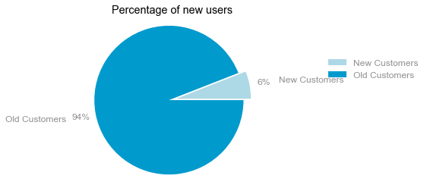
The Ratio of New Users to Old Customers
Based on the graph above, it is clear that the proportion of new customers is relatively tiny by comparison to the proportion of old customers. Therefore, one of the key focus for the company is to expand the new customers in order to expand the cross-selling business.
The group of old customers has bigger age span than the group of new customers has. Other than that, two groups of customers have the different medians and the IQRs, so the majorities of customers' age from 20 to 40 is the main force of the new customers. Hence, the company can put more attention on the product for 20 to 40 age for attracting new customers in the business of cross selling.

Slide 5
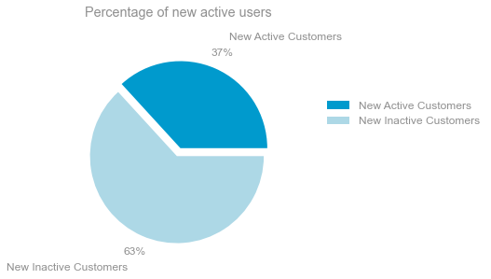
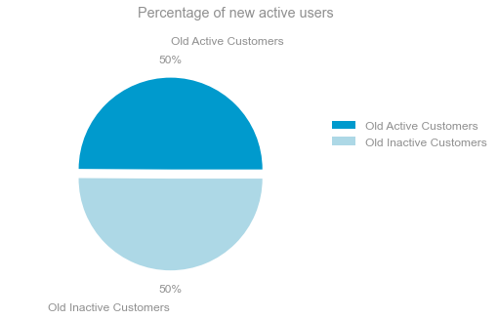
Percentage of Active Users
Based on two pie charts above, which display the ratio of active and inactive customers in the groups of new and old customers main aged group, it obvious that the number of active customers is dominated that of inactive customers in the group of new customers. However, in the group of old customers, the number of active customers is equal to that of inactive customers. Therefore, expanding the business for new customers is the key to success in cross selling.

Slide 6
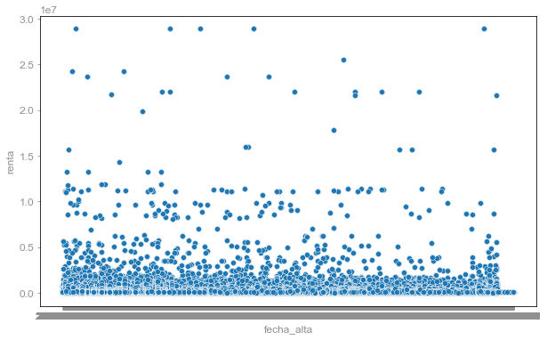
The Relationship between time frame and income
The above scatter plot display no relationship between the time frame the customer became as the first holder of a contract in the bank and his gross household income. Hence, the company should have more focuses on the investment product attract the customers to invest for growth of gross household income.

Slide 7
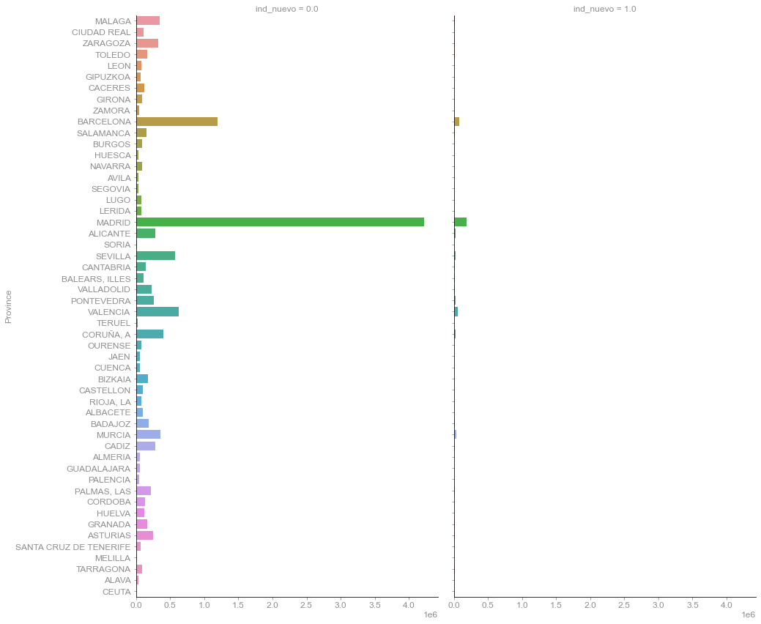
Customers distribution among provinces
Based on the bar graph above, the Madrid is the key province to keep developing the business because this province has massive number of old and new customers by comparison to other provinces. Hence, Madrid should be the core province of cross-selling business.

Slide 8
Conclusion
Based on the analysis, the company put their focus on the sections mentioned before in order to expand their cross-selling business, which includes expanding the group of new customers, providing more investment product related the growth of household income, developing more different aspects of products for more active users.

